Slide 1
UNIT – IV
Programmable Logic devices, Memory and Logic Families

Slide 2
Programmable Logic Devices (PLD)
Programmable Logic Devices (PLDs) are IC chips with internal logic gates connected by electronic fuses.
These fuses can be ‘blown’ (by programming) to obtain different circuit configurations.
Semi-customized chips that give high packing density at reasonable cost.
Three classes of PLDs are :
Programmable Logic Array (PLA)
Programmable Read Only Memory (PROM)
Programmable Array Logic (PAL)

Slide 3
Programmable Logic Devices
Fixed
AND array
Fuses
Fused
programmable
OR array
Inputs
Outputs
Programmable Read Only Memory (PROM)
Fuses
Fused
programmable
AND array
Fixed
OR array
Inputs
Outputs
Programmable Array Logic (PAL)
Fuses
Fused
programmable
AND array
Fuses
Fused
programmable
OR array
Inputs
Outputs
Programmable Logic Array (PLA)

Slide 4
Programmable Logic Array (PLA)
Combination of a programmable AND array followed by a programmable OR array.
Example: Design a PLA to realise the following three logic functions and show the internal connections.
f₁(A,B,C,D,E) = A'.B'.D' + B'.C.D' + A'.B.C.D.E'
f₂(A,B,C,D,E) = A'.B.E + B'.C.D'.E
f₃(A,B,C,D,E) = A'.B'.D' + B'.C'.D'.E + A'.B.C.D

Slide 5
Realising Logic Functions with PLAs
f₁(A,B,C,D,E) = A'.B'.D' + B'.C.D' + A'.B.C.D.E'
f₂(A,B,C,D,E) = A'.B.E + B'.C.D'.E
f₃(A,B,C,D,E) = A'.B'.D' + B'.C'.D'.E + A'.B.C.D
A
X
X
X
X
B
X
X
X
X
X
X
X
C
X
X
X
X
Programmable AND array
X
D
X
X
X
X
X
X
E
X
X
X
X
A'.B'.D'
B'.C.D'
A'.B.C.D.E'
Programmable OR array
X
X
X
f₁
f₂
f₃
X
X
X
X
X
P₁
P₂
P₃
P₄
P₅
P₆
P₇
A'B'D'
A'BCDE'
B'CD'E
A'BCD
B'CD'
A'BE
B'C'D'E

Slide 6
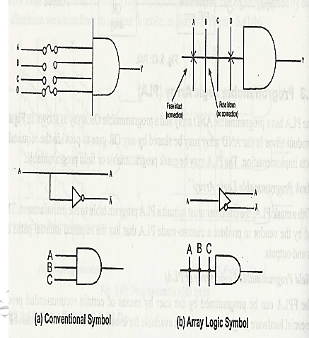

Slide 7

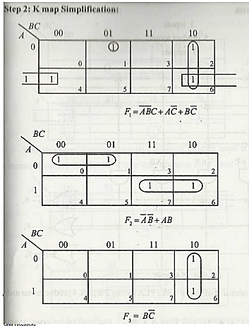
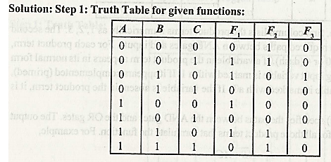

Slide 8
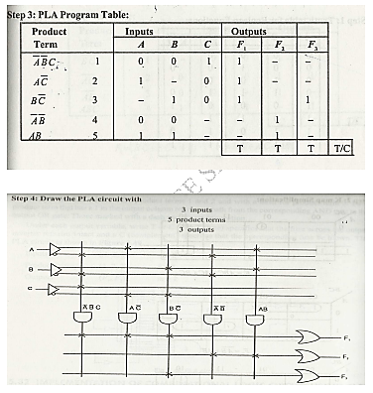

Slide 9
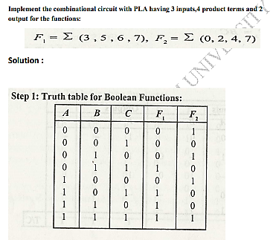

Slide 10
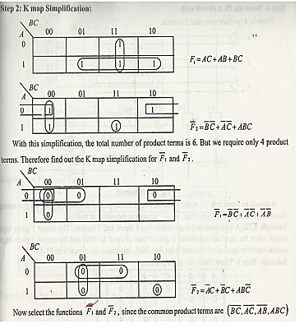

Slide 11
